Slide 1

Parallel and Distributed Computing
2b. Types of DS

Slide 2
Distributed Systems
(3rd Edition)
Chapter 01: Introduction
Version: Feb. 2017
Revised: Oct. 2021

Slide 3
Introduction: Types of distributed systems
Three types of distributed systems
High performance distributed computing systems Distributed information systems
Distributed systems for pervasive computing

Slide 4
Parallel computing
Introduction: Types of distributed systems High performance distributed computing
Observation
High-performance distributed computing started with parallel computing
Multiprocessor and multicore versus multicomputer
Shared memory Private memory
M M M
Interconnect P P
M M M M
P P P P
P
P
Interconnect
Processor
Memory

Slide 5
Distributed shared memory systems
Introduction: Types of distributed systems High performance distributed computing
Observation
Multiprocessors are relatively easy to program in comparison to multicomputers, yet have problems when increasing the number of processors (or cores).Solution: Try to implement ashared-memory modelon top of a multicomputer.
Example through virtual-memory techniques
Map all main-memory pages (from different processors) into one single virtual address space. If process at processor A addresses a page P located at processor B, the OS at A traps and fetches P from B, just as it would if P had been located on local disk.
Problem
Performance of distributed shared memory could never compete with that of multiprocessors, and failed to meet the expectations of programmers. It has been widely abandoned by now.

Slide 6
Cluster computing
Introduction: Types of distributed systems High performance distributed computing
Essentially a group of high-end systems connected through a LAN Homogeneous: same OS, near-identical hardware
Single managing node
Master node
Compute node
Compute node
Compute node
Management application
Component of
parallel application
Component of
parallel application
Component of
parallel application
Parallel libs
Local OS
Local OS
Local OS
Local OS
Remote access network
Standard network
High-speed network
Linux based Beowulf Cluster architecture
Cluster computing
31 / 56

Slide 7
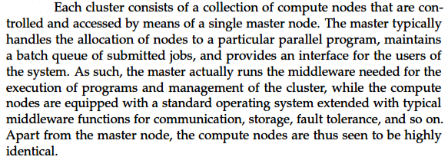
Beowulf Cluster functioning
Introduction: Types of distributed systems High performance distributed computing
Cluster computing: Beowulf Cluster Functioning

Slide 8
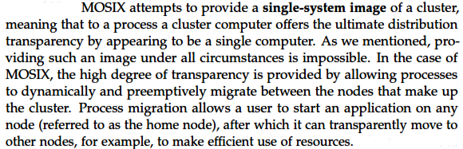
Beowulf Cluster functioning
Introduction: Types of distributed systems High performance distributed computing
Cluster computing: MOSIX Cluster Functioning

Slide 9
Grid computing
Introduction: Types of distributed systems High performance distributed computing
The next step: lots of nodes from everywhere Heterogeneous
Dispersed across several organizations Can easily span a wide-area network
Note
To allow for collaborations, grids generally usevirtual organizations. In essence, this is a grouping of users (or better: their IDs) that will allow for authorization on resource allocation.
Grid computing

Slide 10
Architecture for grid computing
Introduction: Types of distributed systems High performance distributed computing
The layers
Fabric:Provides interfaces to local resources (for querying state and capabilities, locking, etc.)
Connectivity:Communication/transaction protocols, e.g., for moving data between resources. Also various authentication protocols.
Resource: Manages a single resource, such as creating processes or reading data.
Collective:Handles access to multiple resources: discovery, scheduling, replication.
Application: Contains actual grid applications in a single organization.
Applications
Collective layer
Connectivity layer
Resource layer
Fabric layer
Grid computing

Slide 11
Cloud computing
Introduction: Types of distributed systems High performance distributed computing
Google docs Gmail YouTube, Flickr
Software
Web services, multimedia, business apps
Application
Software framework (Java/Python/.Net) Storage (databases)
MS Azure
Google App engine
Platform
Platforms
Amazon S3 Amazon EC2
Computation (VM), storage (block, file)
Infrastructure
Infrastructure
CPU, memory, disk, bandwidth
Datacenters
Hardware
Cloud computing

Slide 12
Cloud computing
Introduction: Types of distributed systems High performance distributed computing
Make a distinction between four layers
Hardware: Processors, routers, power and cooling systems. Customers normally never get to see these.
Infrastructure: Deploys virtualization techniques. Evolves around allocating and managing virtual storage devices and virtual servers.
Platform: Provides higher-level abstractions for storage and such. Example: Amazon S3 storage system offers an API for (locally created) files to be organized and stored in so-calledbuckets.
Application: Actual applications, such as office suites (text processors, spreadsheet applications, presentation applications). Comparable to the suite of apps shipped with OSes.
Cloud computing

Slide 13
Is cloud computing cost-effective?
Introduction: Types of distributed systems High performance distributed computing
Observation
An important reason for the success of cloud computing is that it allows organizations tooutsourcetheir IT infrastructure: hardware and software. Essential question:is outsourcing also cheaper?
Approach
Considerenterprise applications, modeled as a collection ofcomponents, each component C_{i} requiring N_{i} servers.
Application now becomes a directed graph, with a vertex representing a
component, and an arc (⁻i→, j) representing data flowing from C_{i} to C_{j} . Two associated weights per arc:
T_{i,j} is the number of transactions per time unit that causes a data flow from C_{i} to C_{j} .
S_{i,j} is the total amount of data associated with T_{i,j} .
Cloud computing

Slide 14
Is cloud computing cost-effective?
Introduction: Types of distributed systems High performance distributed computing
Migration plan
Figure out for each component C_{i} , how many n_{i} of its N_{i} servers should migrate, such that the monetary benefits reduced by additional costs for Internet communication, are maximal.
Requirements migration plan
Policy constraints are met.
Additional latencies do not violate specific delay constraints.
All transactions continue to operate correctly; requests or data are not lost during a transaction.
1
2
3
Cloud computing

